Slide 1
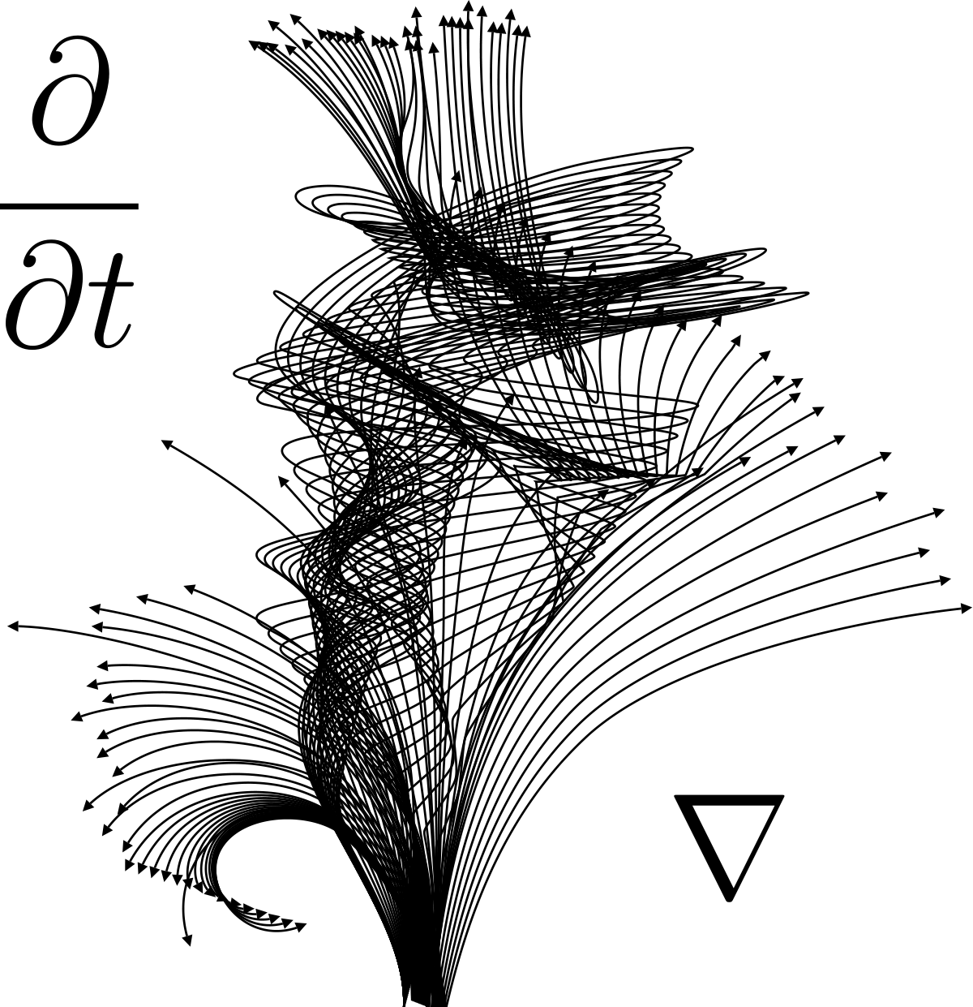
General Relativity and Stars
Selim Kalici
State University of New York at Oswego
AST405: Introduction to Astrophysics

Slide 2
Hydrostatic Equilibrium
Stars in our universe constantly are fighting against gravitational collapse
When the internal pressure pushing out of a star equals in the gravitational pressure inwards, this is hydrostatic equilibrium
We can use this effect to describe the pressure and physics inside a star
Selim Kalici – SUNY Oswego – AST405

Slide 3
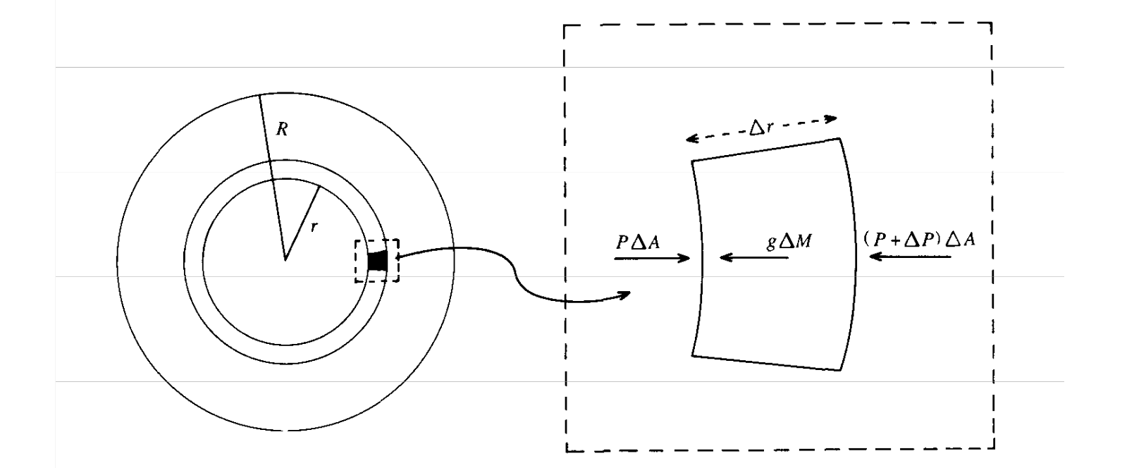
Hydrostatic Equilibrium
Selim Kalici – SUNY Oswego – AST405

Slide 4
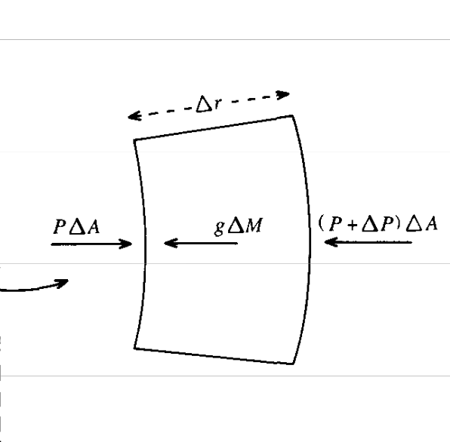
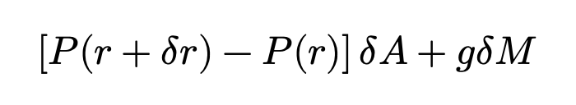
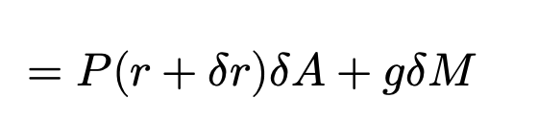
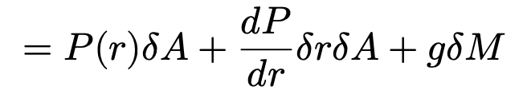
Hydrostatic Equilibrium
P: Pressure at the radius r
g: gravitational acceleration at radius r
M: mass at radius r
Selim Kalici – SUNY Oswego – AST405

Slide 5
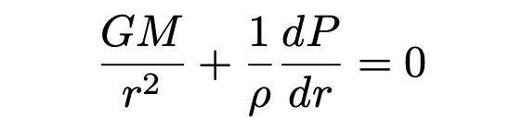


Hydrostatic Equilibrium
The sum of the forces inside the star must be 0, as H.E. requires the acceleration to be 0
The equation of hydrostatic equilibrium tells us the necessary relationship between pressure and gravitational energy
Selim Kalici – SUNY Oswego – AST405

Slide 6
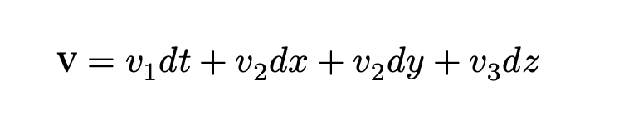
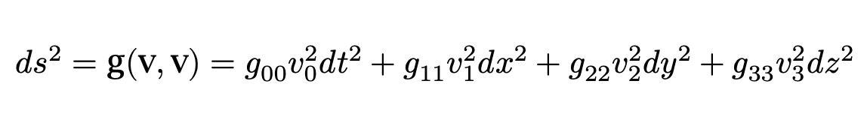
The Metric Tensor
The metric tensor describes how to find distances in curved spacetimes
For some vector
We define its inner product via
Which is the spacetime interval along that vector
Selim Kalici – SUNY Oswego – AST405

Slide 7
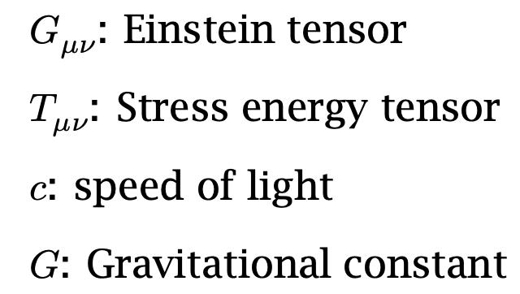
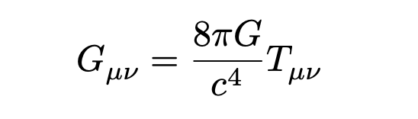
Einstein’s Field Equations
The Einstein tensor describes the curvature of spacetime
The stress-energy tensor describes the energy present in a space and how it moves throughout
Selim Kalici – SUNY Oswego – AST405

Slide 8
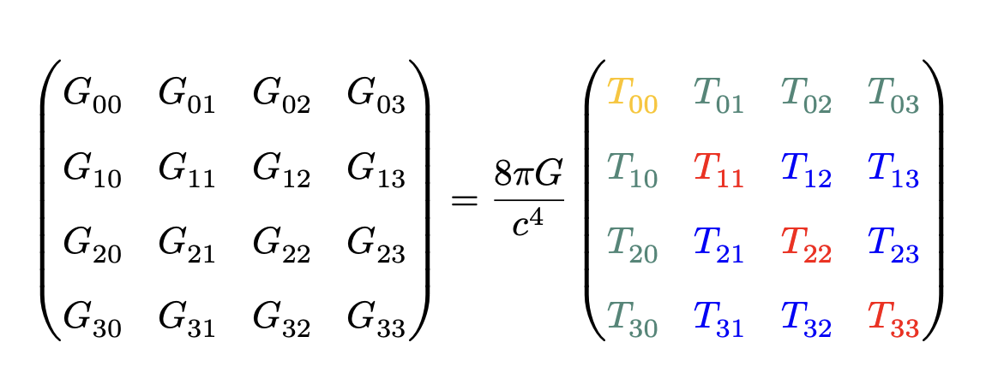
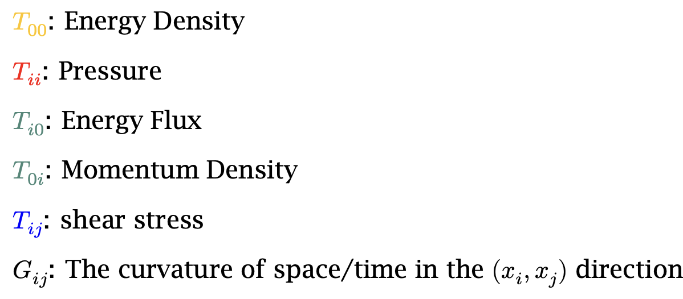
Einstein’s Field Equations
The Einstein Field Equations describe the curvature of space time as a function of the energy present in the space
These lead to a set of 16 coupled partial differential equations depending mainly on the metric chosen
Selim Kalici – SUNY Oswego – AST405

Slide 9
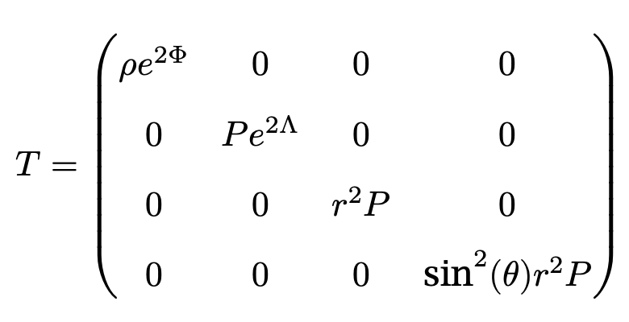
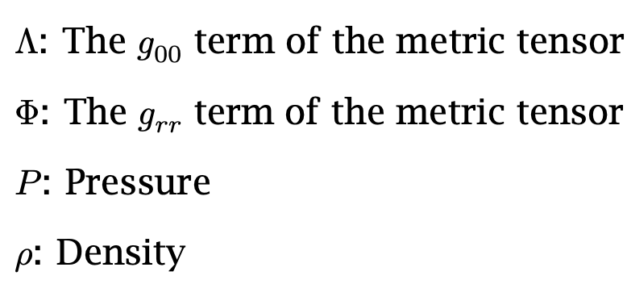
The Stress-Energy Tensor
If we assume the star is an ideal gas, the stress energy tensor is diagonal and takes the form
Selim Kalici – SUNY Oswego – AST405

Slide 10
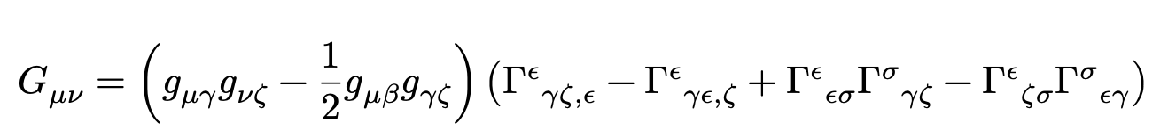

The Einstein Tensor
The Einstein Tensor components are explicitly given in terms of the metric
Energy and mass change the curvature of spacetime which changes the way distances are computed
This changes the apparent path taken in spacetime
Selim Kalici – SUNY Oswego – AST405

Slide 11
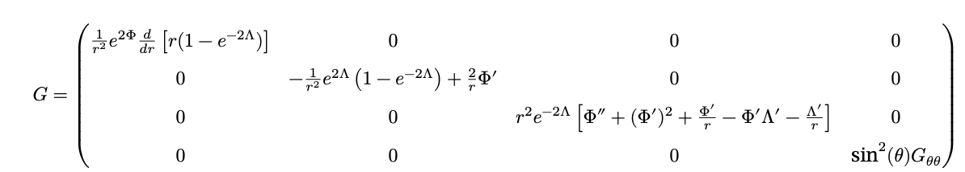
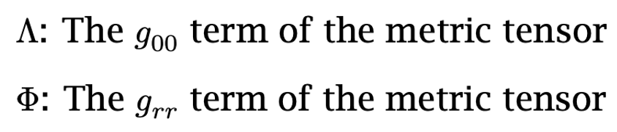
The Einstein Tensor
The Einstein matrix is given by
Selim Kalici – SUNY Oswego – AST405

Slide 12
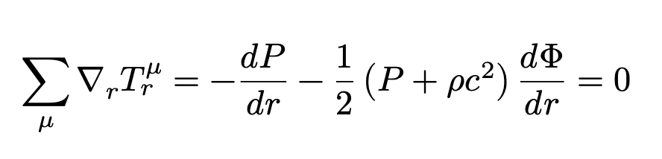
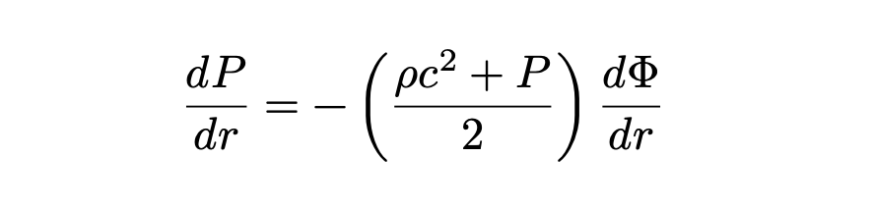
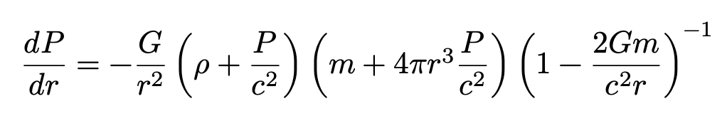
Solving the Field Equations
By the conservation of energy, the derivative of the stress energy tensor is 0
Selim Kalici – SUNY Oswego – AST405

Slide 13
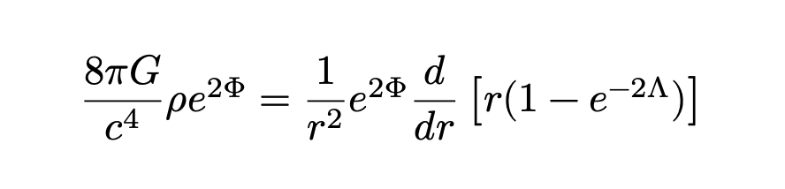

Solving the Field Equations
The first diagonal term of the field equations
Integrating this equation by parts we find
Selim Kalici – SUNY Oswego – AST405

Slide 14
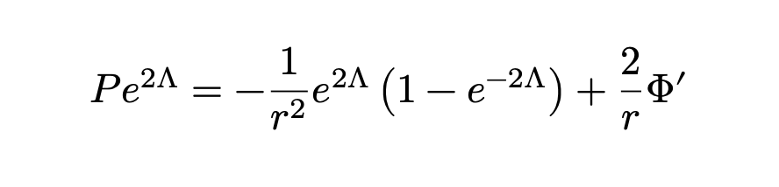
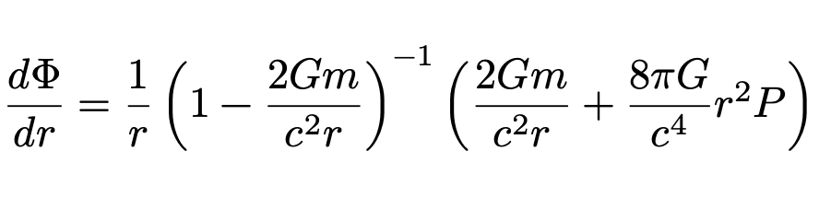
Solving the Field Equations
The second diagonal term of the field equations
Plugging in our previous equation:
Selim Kalici – SUNY Oswego – AST405

Slide 15
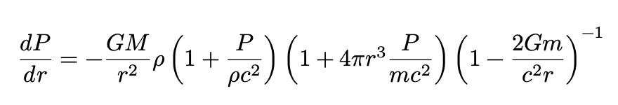
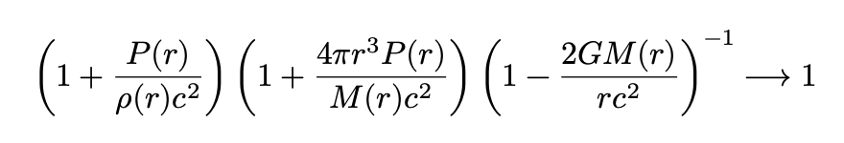
The limiting case
We may rewrite the equation as follows
Then we treat the limiting case and let $c\underset{→}{}∞$
The Newtonian approximation!
Selim Kalici – SUNY Oswego – AST405

Slide 16
Conclusions
The general relativistic hydrostatic equilibrium equation evolves a simple separation of variables into a non-linear first order differential equation
The limiting case of this equation brings us right to the Newtonian approximation
Selim Kalici – SUNY Oswego – AST405

Slide 17
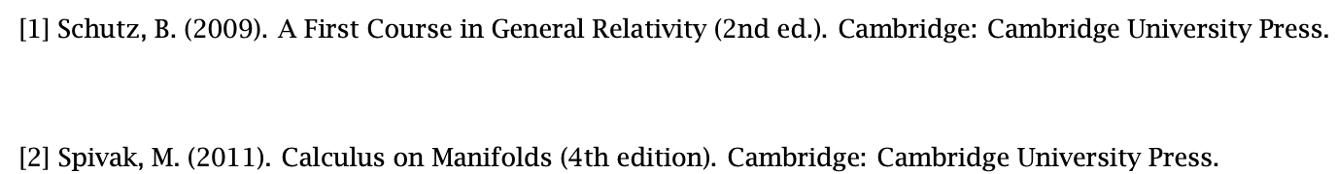
References
Selim Kalici – SUNY Oswego – AST405

